Slide 1
Integumentary System
Chapter 6
SKIN

Slide 2
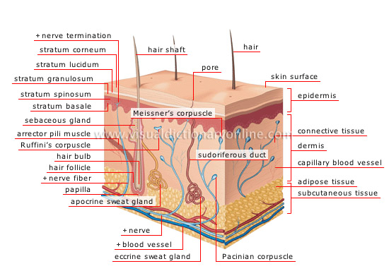
Introduction
Organs are composed of two or more kinds of tissues
The skin and its accessory organs constitute the integumentary organ system

Slide 3
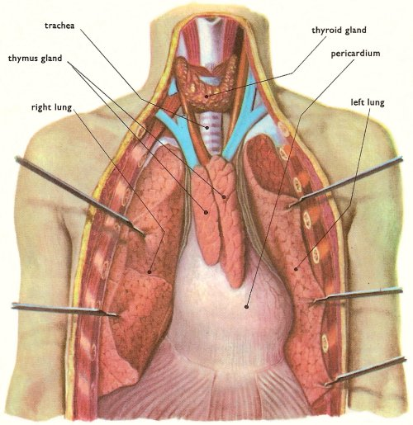
Types of Membranes
Serous Membranes
Line body cavities that lack openings to the outside
Cells secrete watery serous fluid that lubricates membrane surfaces.

Slide 4
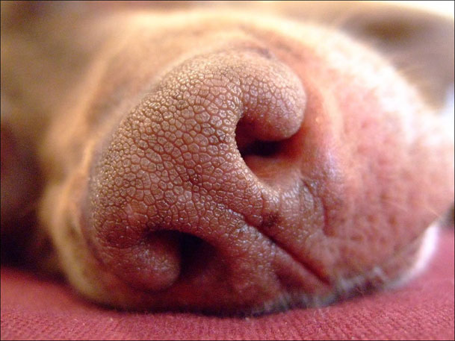
Types of Membranes Cont.
Mucous Membranes
Lines cavities and tubes that open to the outside
Cells secrete mucus

Slide 5
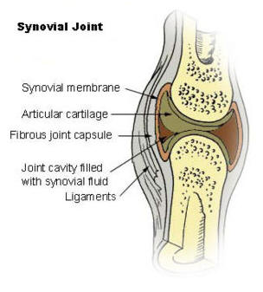
Types of Membranes Cont.
Synovial Membranes
Lines joint cavities
Secret synovial fluid that lubricates ends of bones at joints

Slide 6
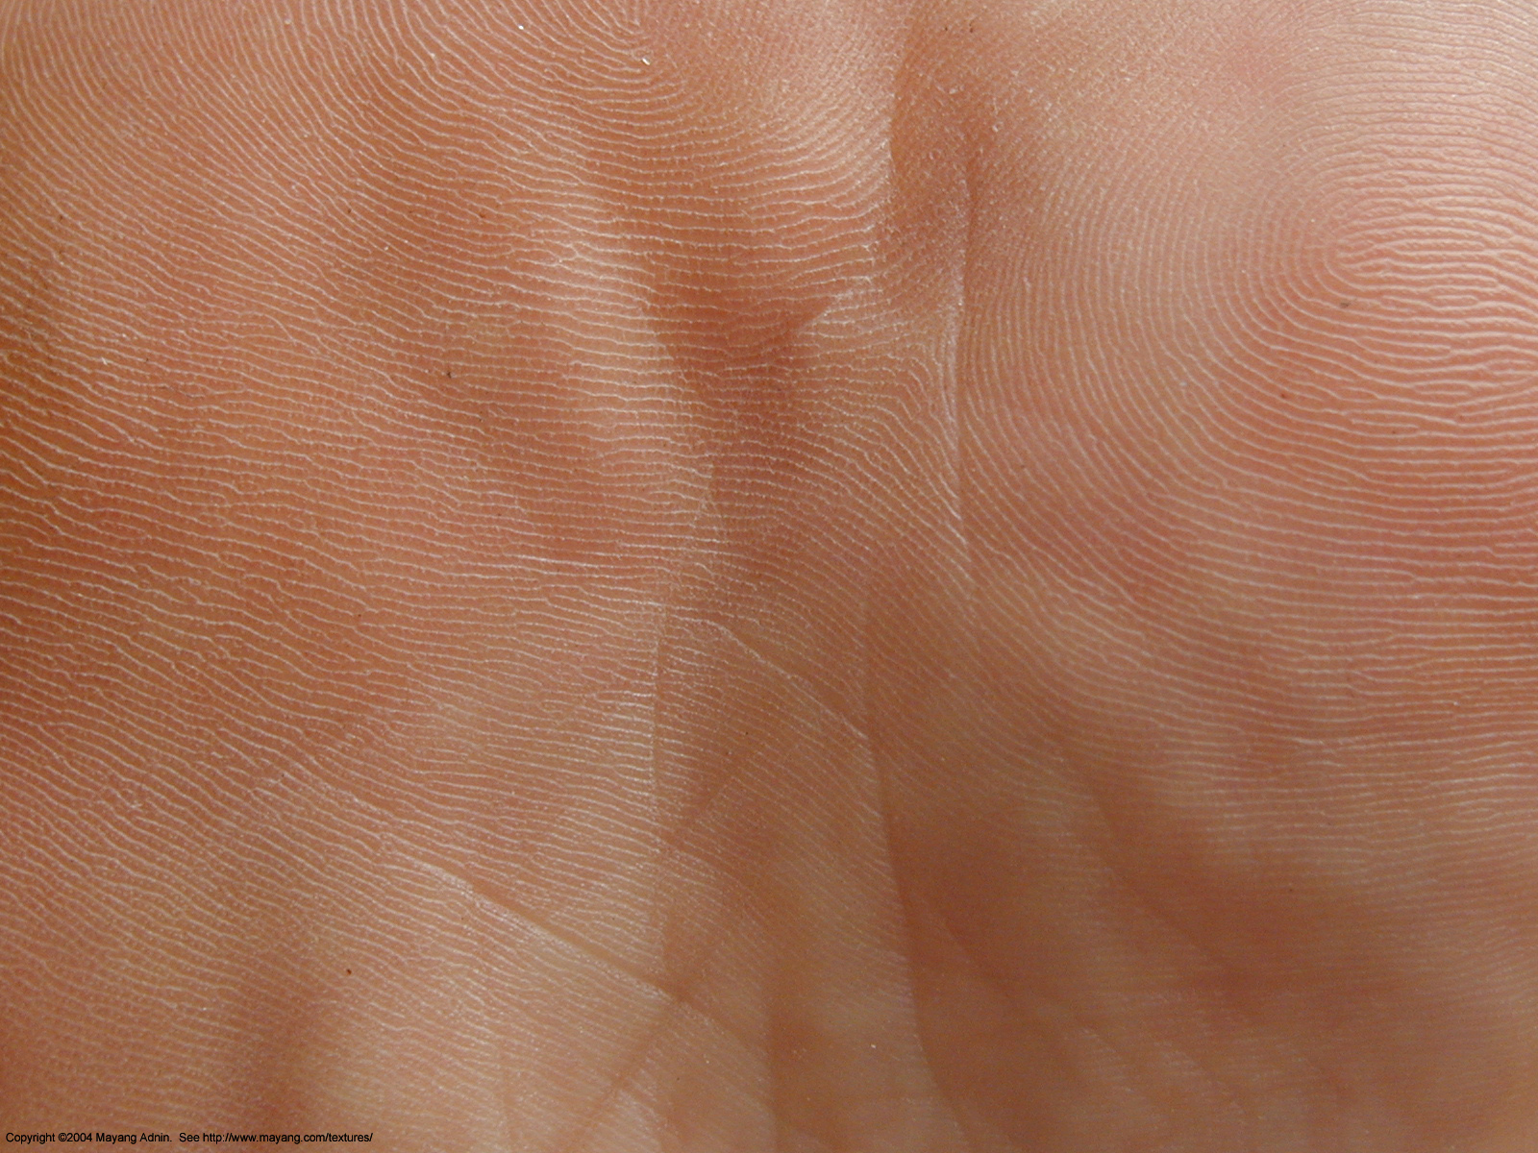
Types of Membranes Cont.
Cutaneous Membrane
Skin

Slide 7
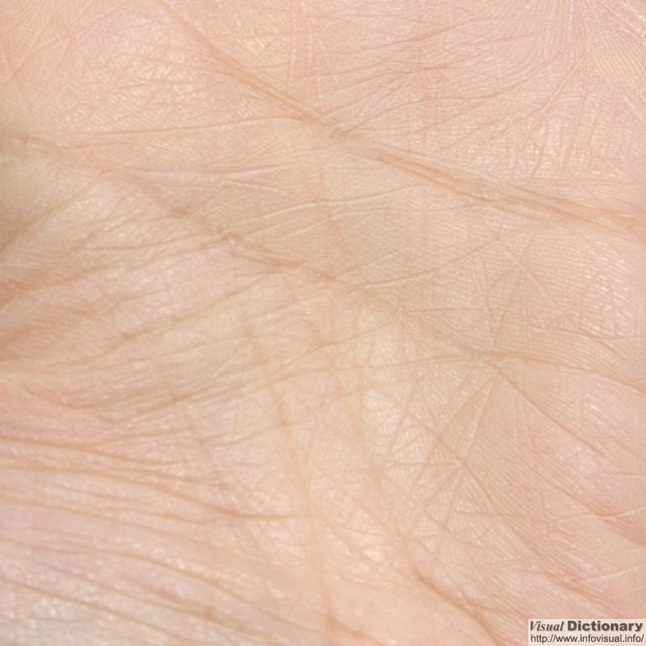
Skin and Its Tissues
Skin is a protective covering
Helps regulate body temperature
Retards water loss
Houses sensory receptors
Synthesizes various chemicals
Excretes wastes
Three Layers
Epidermis
Dermis
Subcutaneous Layer (SubQ) (hypodermis)

Slide 8
Epidermis
Outermost layer of skin composed of epidermal cells
Deepest layer of epidermis contains cells that undergo Mitosis
Cells undergo keratinization as they mature and are pushed toward the surface
Keratin: A tough, insoluble protein substance that is the chief structural constituent of hair, nails, horns, and hooves.
Protects underlying tissues against water loss, mechanical injury, and effects of harmful chemicals.

Slide 9
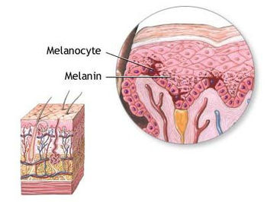
Epidermis Cont.
Melanin protects underlying cells from effects of UV Light
Melanin: any of a class of insoluble pigments, found in all forms of animal life, that account for the dark color of skin, hair, fur, scales, feathers, etc.
Melanocytes transfer melanin to nearby epidermal cells
All humans possess same concentration of melanocytes

Slide 10
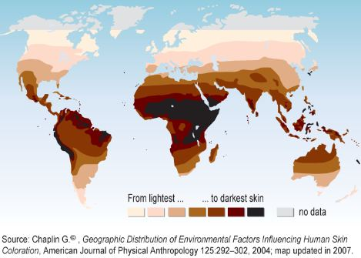
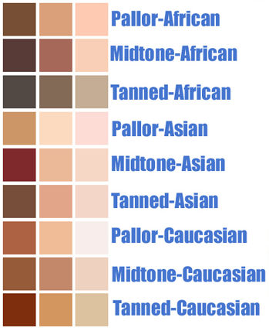
Epidermis: Skin Color
Skin Color is due to amount of melanin and size of the pigment granules in the epidermis
Skin color is influenced by environmental and physiological factors, as well as genes.
Pinkish skin is caused by well oxygenated blood and blueish skin (cyanosis) is caused by low amounts of oxygen in blood.

Slide 11
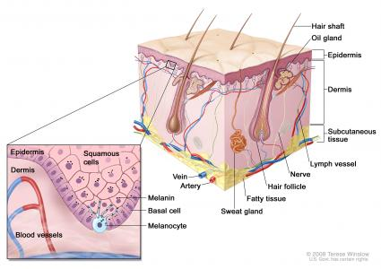
Dermis
Layer that binds epidermis to underlying tissues
Blood vessels supply nutrients to all skin cells and regulate body temp.
Contains
hair follicles,
sebaceous
glands, and
sweat glands.

Slide 12
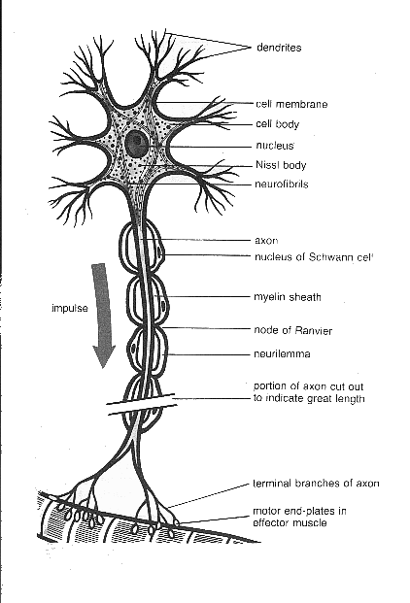
Dermis: Nervous Tissue
Scattered throughout the dermis
Some dermal nerve fibers carry impulses to muscles and glands of the skin
Other dermal nerve fibers are associated with various sensory receptors in the skin

Slide 13
Subcutaneous Layer (Sub Q)
Composed of loose connective tissue and adipose tissue
Adipose conserves body heat
Contains blood vessels that supply the skin and underlying adipose tissue

Slide 14
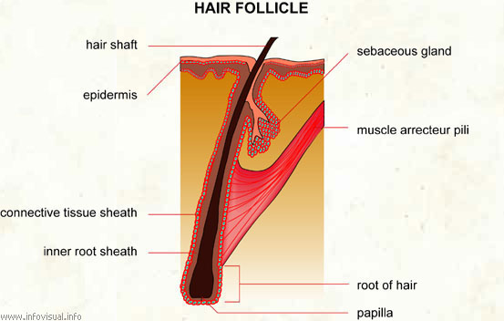
Accessory Organs of the Skin
Hair Follicle
Each hair develops from epidermal cells at the base of a hair follicle
Newly formed cells developed and grow; older cells are pushed toward the surface and undergo keratinization.
Bundle of smooth muscle cells is attached to each hair follicle
Arrector Pili muscle keeps hair upright
Contraction leads to goosebumps

Slide 15
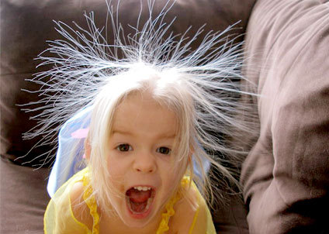
Hair Color
Hair color is determined by melanin produced by the melanocytes associated with hair follicles.
Dark hair produces abundance of melanin
Blond hair produces intermediate amount of melanin
White Hair produces no melanin
Red hair produces trichosiderin (only found in red hair)
Hair Types
Vellus-pale, fine body hair found in children and the adult female
Terminal-Course, long hair of eyebrows, scalp, axillary(armpit), and pubic regions

Slide 16
Hair Thinning and Baldness
Alopecia-Hair thinning in both sexes
True or Frank Baldness
Genetically determined and sex influenced condition
Male pattern Baldness
Hormones in females don’t allow baldness

Slide 17
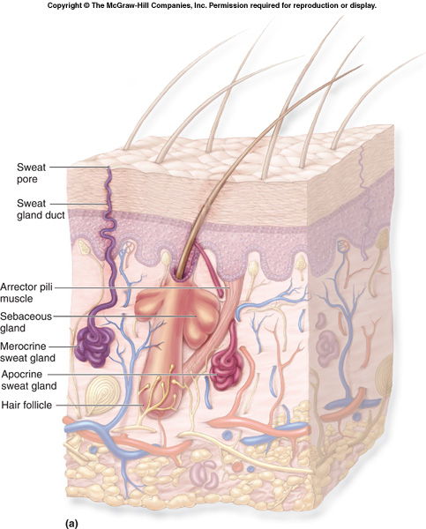
Sebaceous Gland
Usually associated with hair follicles
Secrete sebum; helps keep skin and hair soft and waterproof
Disorder of Gland
Acne

Slide 18
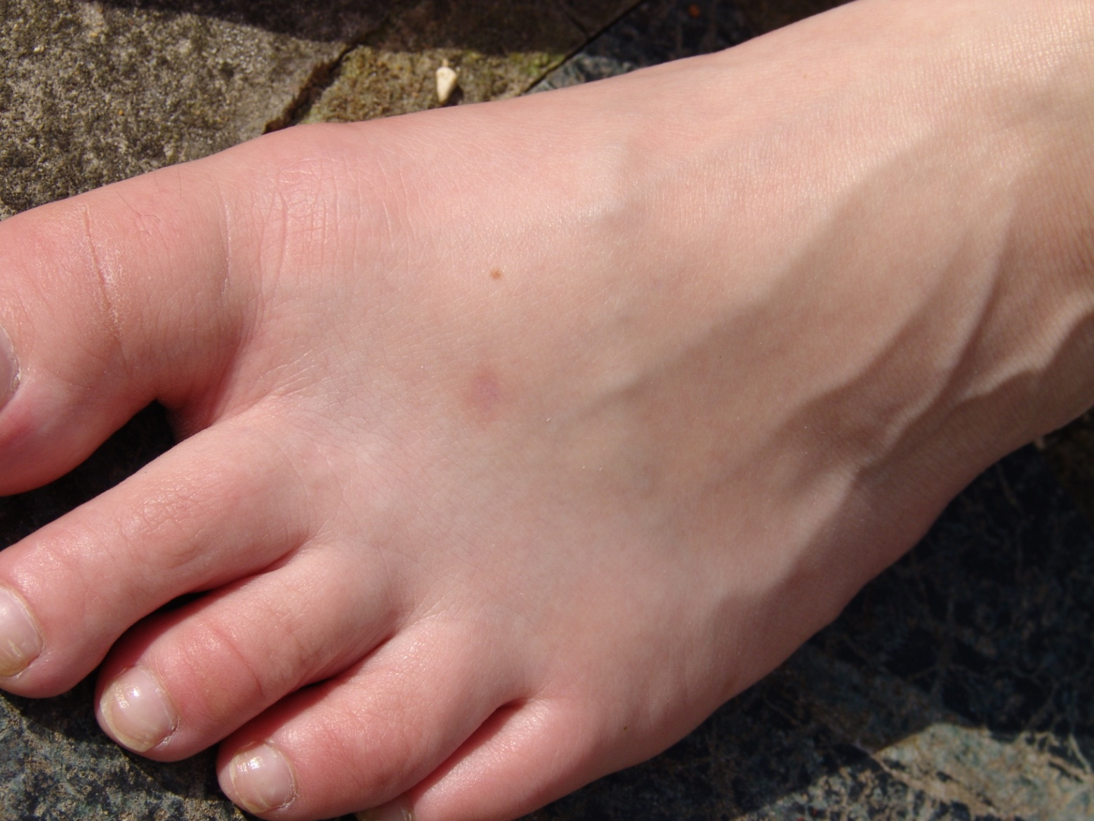
Nails
Produced by epidermal cells that undergo keratinization

Slide 19
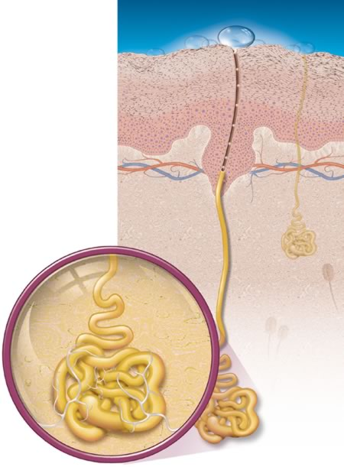
Sweat Glands
Consists of a coiled tub
Apocrine glands respond to emotional stress
Developed when you hit puberty
Eccrine glands respond to an elevated body temp.
Exercise
Sweat is primarily water, also contains salts and waste products

Slide 20
Regulation of Body Temp.
Vital because heat affects the rates of metabolic reactions
98.6 degrees F or 37 degrees C is average
Heat Production and Loss
As body temp. rises above normal, dermal blood vessels dialate and sweat glands secrete sweat.
As temp. drops below normal, dermal blood vessels constrict and seat glands become inactive.
During excessive heat loss, the skeletal muscles are stimulated to contract involuntarily.

Slide 21
Healing Wounds
Inflammation (swelling): normal response to injury
Blood vessels around wound dilate allowing more blood flow to the area
Inflamed skin becomes reddened, swollen, warm, and painful to touch
Shallow break in skin: epidermal cells are stimulated to reproduce more rapidly and fill the gap
Dermal and Sub Q wounds: blood clot forms along with a scab to protect underlying tissues
Deep wounds lead to scars

Slide 22
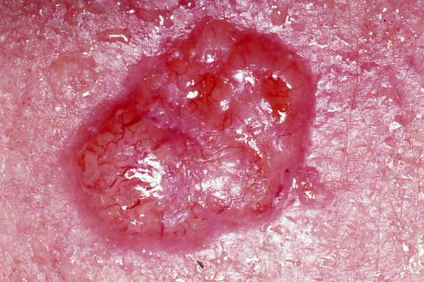
Skin Cancer
Basal Cell Carcinoma
Least malignant and most common
Stratum basale cells (epidermis) proliferate and invade the dermis and hypodermis
Slow growing and do not often metastasize
Can be cured by surgical excision in 99% of the cases

Slide 23
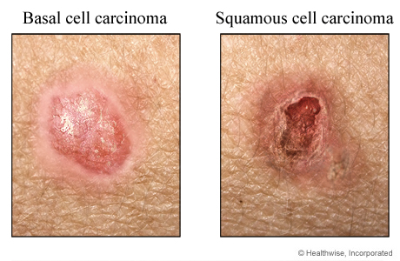
Skin Cancer Cont.
Squamous Cell Carcinoma
Arises from keratinocytes of stratum spinosum (epidermis)
Arise most often on scalp, ears, and lower lip
Grows rapidly and metastasizes if not removed
Prognosis is good if treated by radiation therapy or removed surgically.

Slide 24
Skin Cancer Cont.
Melanoma
Cancer of melanocytes is most dangerous type
Melanomas have the following characteristics (ABCD rule)
A: Asymmetry; the two sides of the pigmented area do not match
B: Border; the border is irregular and exhibits indentations
C: Color; (pigmented area) is black, brown, tan, or sometimes red or blue
D: Diameter; the diameter is larger than 6 mm (side of pencil eraser)
Treated by wide surgical excision accompanied by immunotherapy
Survival is poor if the lesion is over 4 mm thick

Slide 25
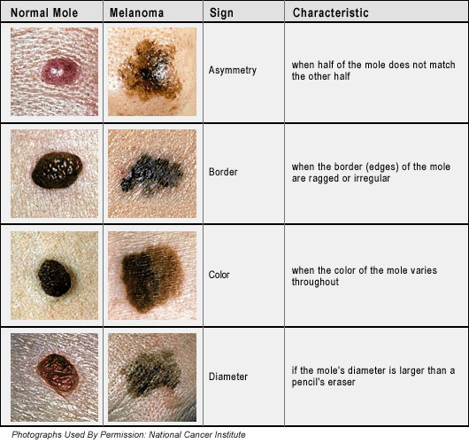
Melanoma

Slide 26
Burns
First Degree-only the epidermis is damaged
Symptoms include localized redness, swelling, and pain
Second Degree-the epidermis and upper regions of the dermis damaged
Symptoms mimic first degree burns, but blisters also appear
Third Degree- involve entire thickness of skin
Burned area appears gray-white, cherry red, or black, and there is not initial edema (swelling) or pain (since nerve endings are destroyed)

Slide 27
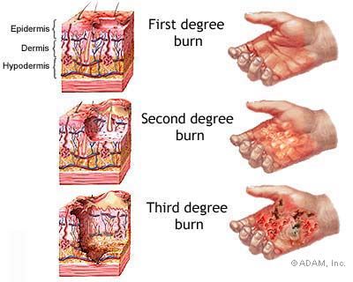
Burns

Slide 28
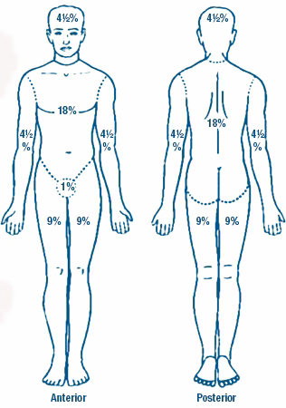
Rule of Nines
Estimate the severity of burns
Burns considered critical if:
Over 25% of the body has a 2nd degree burn
Over 10% of the body has 3rd degree
There are 3rd degree burns on face, hands or feet

